Slide 1
App to App Communication Developer’s Guide to Windows 10

Slide 2
Agenda
App to App in Windows 10 UWP
URI and Protocol Activation
Share Contract
URI Activation to a Specific App
Send Files
Query Uri Support
App Services
Shared Storage
Publishers’ Shared Storage Folder

Slide 3
App to App in Windows 10 UWP

Slide 4
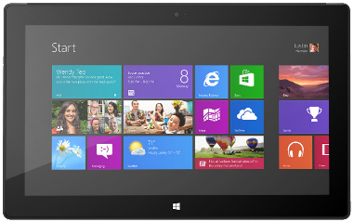


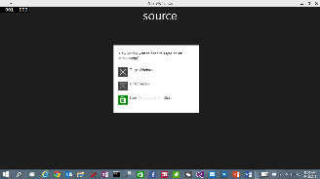
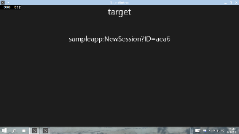





URI/Protocol Activation (also in Windows 8.1)
Launcher.LaunchUriAsync(new Uri("sampleapp:?ID=aea6"));
Launcher.LaunchFileAsync(file);
Data in Uri/File
User/OS chooses target

Slide 5
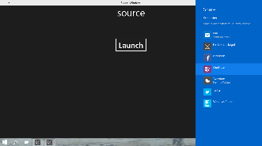



Share Contract (also in Windows 8.1)
DataTransferManager.ShowShareUI();
Share DataPackage
User chooses target

Slide 6

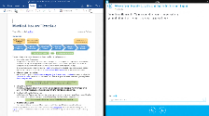

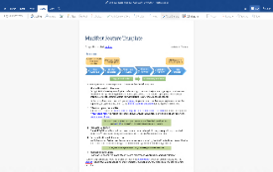
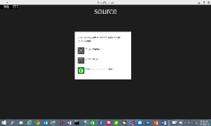

Enhanced App to App in Windows 10
Launch a *specific* app
Send file token, send data
Launch for Results
App Services

Slide 7
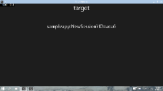


URI Activation++
Invoke a specific app
var options = new LauncherOptions();
options.TargetApplicationPackageFamilyName = "24919.InstapaperIt";
var launchUri = new Uri("instapaper:?AddUrl=http%3A%2F%2Fbing.com");
await Launcher.LaunchUriAsync(launchUri, options);

Slide 8
URI Activation++
Send Files
var options = new LauncherOptions();
options.TargetApplicationPackageFamilyName = "24919.InstapaperIt";
var token = SharedStorageAccessManager.AddFile (gpxFile);
ValueSet inputData = new ValueSet();
inputData.Add("Token", token);
var launchUri = new Uri("instapaper:?AddUrl=http%3A%2F%2Fbing.com");
await Launcher.LaunchUriAsync(launchUri, options, inputData);

Slide 9
Query URI Support
Discover if app already installed to handle a Uri
var queryUri = new Uri("instapaper:");
await Launcher.QueryUriSupportAsync(queryUri, LaunchUriType.LaunchUri);
var queryUri = new Uri("instapaper:");
string packageFamilyName = "24919.InstapaperIt";
await Launcher.QueryUriSupportAsync(queryUri, LaunchUriType.LaunchUriForResults, packageFamilyName);
?

Slide 10

App Services Covered in separate module
Client App A
App with App Service
Client App B
Background Task

Slide 11
URI Activation for Device Settings
Category | Settings page | Mobile and/or Desktop | Uri
System | Display (on desktop) Screen (on mobile) | Both | ms-settings:display
 | Notifications | Both | ms-settings:notifications
 | Storage Sense | Desktop only | ms-settings:storagesense
 | Battery Saver | Both | ms-settings:batterysaver
 | Offline Maps | Both | ms-settings:maps
Devices | Bluetooth | Both | ms-settings:bluetooth
Network and Wi-fi | Wi-Fi | Mobile Desktop | ms-settings:wifi ms-settings:network-wifi
 | Airplane mode | Mobile Desktop | ms-settings-airplanemode: ms-settings:network-airplanemode
 | Cellular | Both | ms-settings:network-cellular
 | Data Sense | Both | ms-settings:datausage
 | Proxy | Desktop only | ms-settings:network-proxy
More… [See documentation for complete list]

Slide 12
Demo: URI Activation in UWP

Slide 13
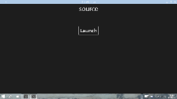

Launch for Results
Launching the app
var options = new LauncherOptions();
options.TargetApplicationPackageFamilyName = "24919.Instap";
var launchUri = new Uri("instapaper:?AddUrl=http%3A%2F%2Fbing.com");
await Launcher.LaunchUriForResultsAsync(launchUri, options, data);
var resultData = new ValueSet();
resultData.Add("Result", value);
operation.ProtocolForResultsOperation.ReportCompleted(resultData);A
App1
App2

Slide 14
Demo: Launch for Results

Slide 15
Publisher’s Shared Storage Folder

Slide 16
Apps from the same publisher share files and settings

Slide 17
Publisher’s shared storage folder
A subfolder is required. Edit app manifest to add. Folders are automatically provisioned.
<Package> <Extensions>
<Extension Category="windows.publisherCacheFolder"> <PublisherCacheFolder> <Folder Name="Folder1"> </PublisherCacheFolder> </Extension>
</Extensions> </Package>

Slide 18
Shared storage folder interaction
Access folder named “fonts”:
Windows.Storage.ApplicationData.Current .GetPublisherCacheFolder("fonts");
Clear shared storage:
Windows.Storage.ApplicationData.Current .ClearPublisherCacheFolderAsync();

Slide 19
Review
App to App in Windows 10 UWP
URI and Protocol Activation
Share Contract
URI Activation to a Specific App
Send Files
Query Uri Support
App Services
Shared Storage
Publishers’ Shared Storage Folder

Slide 20
Sharing Example

Slide 21
Share Contract (also in Windows 8.1)
DataTransferManager.ShowShareUI();
Share DataPackage
User chooses target

Slide 22
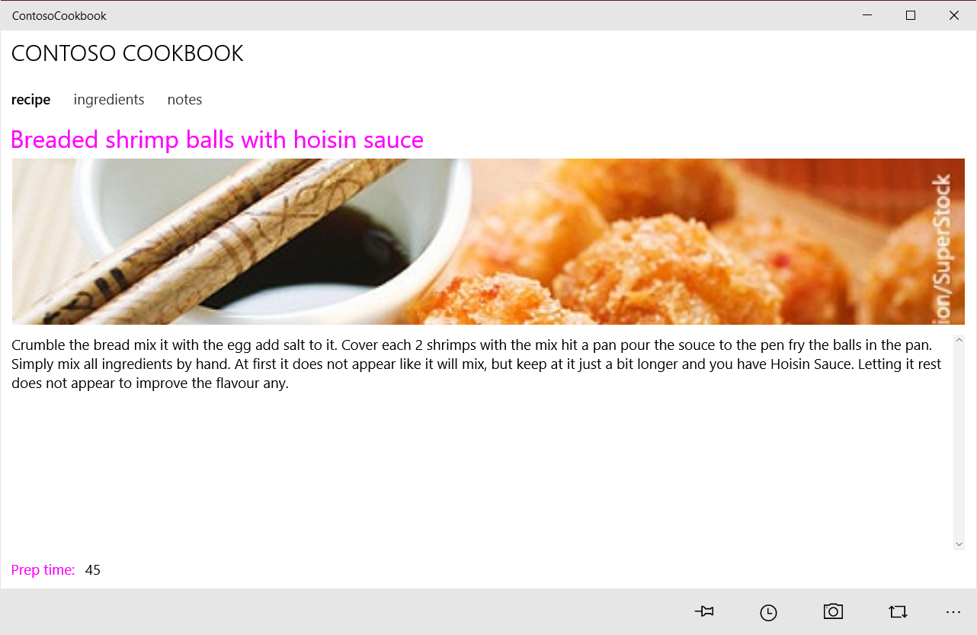
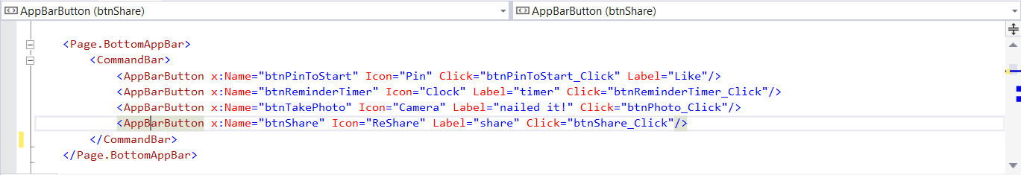
UWP Apps must show Share UI

Slide 23
Implementing share source
protected override void OnNavigatedTo(NavigationEventArgs e) { … DataTransferManager.GetForCurrentView().DataRequested += OnShareDataRequested; } protected override void OnNavigatedFrom(NavigationEventArgs e) { … DataTransferManager.GetForCurrentView().DataRequested -= OnShareDataRequested; } private void AppBarButton_Click(object sender, RoutedEventArgs e) { DataTransferManager.ShowShareUI(); }
! Always remove your event handlers
Always tear down your event handlers when you’re done with them
Notes:
You must subscribe to the DataRequested event so that the shell Share UI component can call you back to find out what your DataPackage contains.
Then call DataTransferManager.ShowShareUI() when the user requests sharing.
Note that the DataRequested event fires before the Share picker UI displays. This is because the shell needs to know what your DataPackage contains (in other words what kinds of content your app has to share) so that it can display an appropriate list of Share targets.

Slide 24
Implementing share source
// Handle DataRequested event and provide DataPackage void OnShareDataRequested(DataTransferManager sender, DataRequestedEventArgs args) { var request = args.Request; request.Data.Properties.Title = "Share example"; //You MUST set a Title! request.Data.Properties.Description = "This demonstrates how to share text to another app"; request.Data.SetText(TextToShare.Text.Trim()); }
Title
You must set a Title on the Data Package. If you do not, the Share operation silently fails.
Description
Not used by the Share UI on Mobile, but displayed by the Desktop Share UI, and is available to the Share target.
Notes:
Then, in the event handler, your source app builds a DataPackage object. There are many DataPackage.SetXXX() methods, for setting content in differing formats. You should try to support as many formats as possible, e.g. Text and HTML. That way the potential number of share targets increases, and the share target will be able to use the richest possible data formats when reading the content and sharing it.

Slide 25
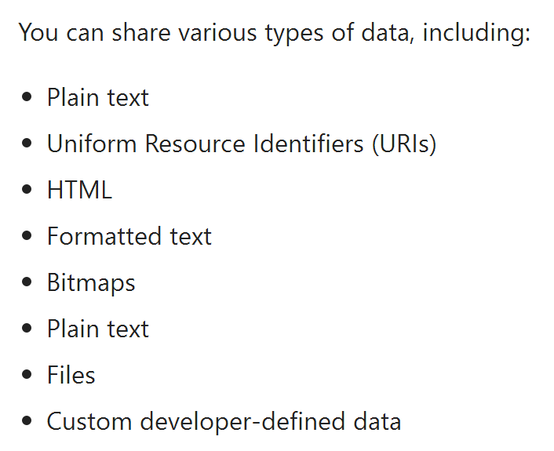
Choose data

Slide 26
Including Files in Data Package
// Handle DataRequested event and provide DataPackage async void OnShareDataRequested(DataTransferManager sender, DataRequestedEventArgs args) { var dp = args.Request.Data; var deferral = args.Request.GetDeferral(); var photoFile = await StorageFile.GetFileFromApplicationUriAsync( new Uri("ms-appx:///Assets/needle.jpg")); dp.Properties.Title = "Space Needle"; dp.Properties.Description = "The Space Needle in Seattle, WA"; dp.SetStorageItems(new List<StorageFile> { photoFile }); dp.SetWebLink(new Uri("http://seattletimes.com/ABPub/2006/01/10/2002732410.jpg")); deferral.Complete(); }
You need to use deferrals when there is an async operation in the request.
Notes:
The previous slide showed how to define simple text in the DataPackage. This slide shows how to include a file in the data package.
Notice that you should call GetDeferral() if you must call any asu=ync methods while constructing the data package, and then call deferral.Complete() when you are done.
General rule of thumb – write code to take the referral regardless of whether you currently have any async code – just to future-proof it in case you add async code in a future update. And make sure you call deferral.Complete(). You could perhaps add try-finally to enforce this?

